Slide 1
Mind Maps

Slide 2
It is a visual Representation of data.
What it does is, it creates association between forms of data and established a network using branches, symbols, colours etc.
So, if you see a google map, you will see that different areas, different places and cities have been connected to each other by roads that is the basic concept of mind map.

Slide 3
3 main Requirements while making mind map
Standard good textbook
Why i am stressing on std good textbook is becuase the core main requirement in making mind maps are keywords.
You will be mentioning only keywords in your mind maps.
Wherever you find these keywords you will find the correct keywords only in your standard textbooks.
So, whenever you are making a mind map make sure that you are using a textbook

Slide 4
Second most important thing is to use colours.
Lots of colours
So, when you look at a map, when you see that you have different colour for different features.
Means different colour for
Process
Input
Output
Condition
Branch

Slide 5
Your brain will automatically understand that you are trying to segregate certain amount of information here and it will easily pick up that information.
Also using colours will make you want to read that information better so use of colors is always recommended.

Slide 6
Third most important thing is dedication and discipline.
Mind Maps helps to retain information for a very long time.

Slide 7
Plain sheets
Lot of colors.

Slide 8
Main Heading Topic

Slide 9
Sub Heading
Main Heading Topic
Sub Heading
Sub Heading
Keyword 1
Keyword 2
Keyword 3
Keyword 4
Sub Heading
Keyword 5

Slide 10
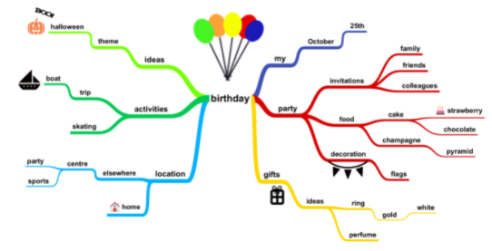

Slide 11
